Slide 1
Principal Component Analysis

Slide 2
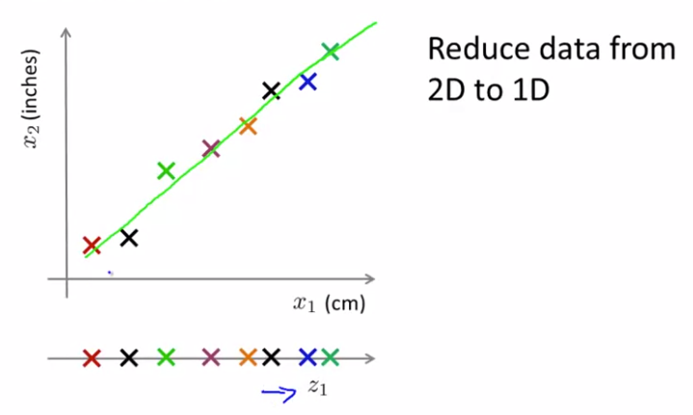
Motivations
Data Compression

Slide 3
Motivations
Data Compression
Dataset has 1000 features, may contain redundant features
-> Want to reduce the number of features
-> Faster training

Slide 4
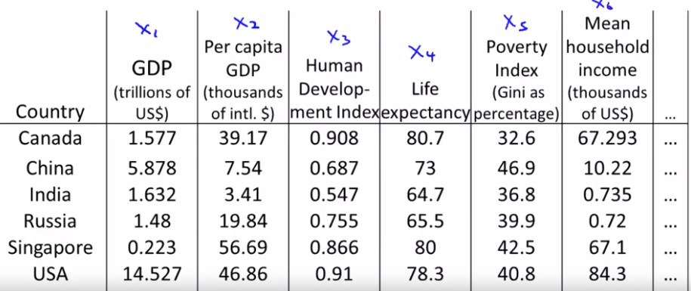
Motivations
Data visualization

Slide 5
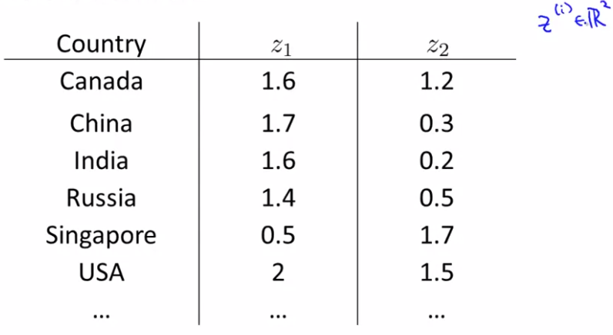
Motivations
Data Visualization

Slide 6
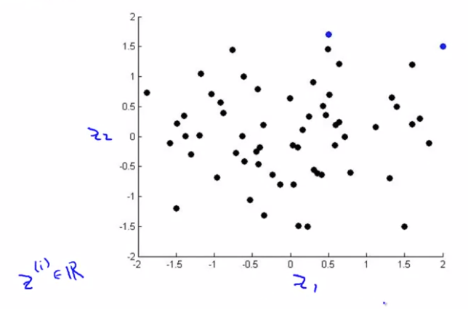
Motivations
Data Visualization

Slide 7
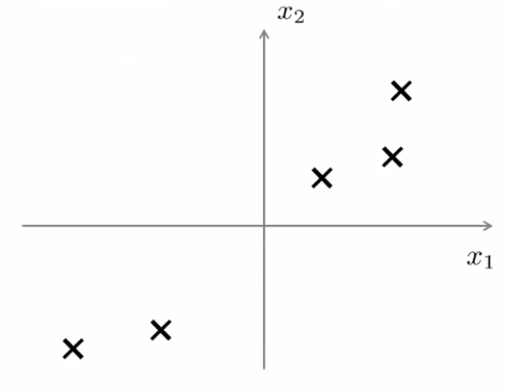

Problem Formulation
$$z$$

Slide 8
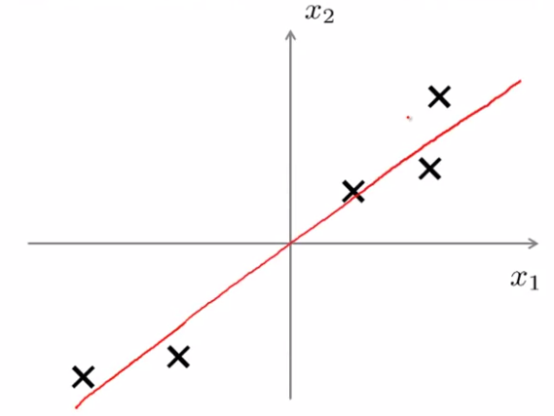
Problem Formulation
Find a line onto which to project data

Slide 9
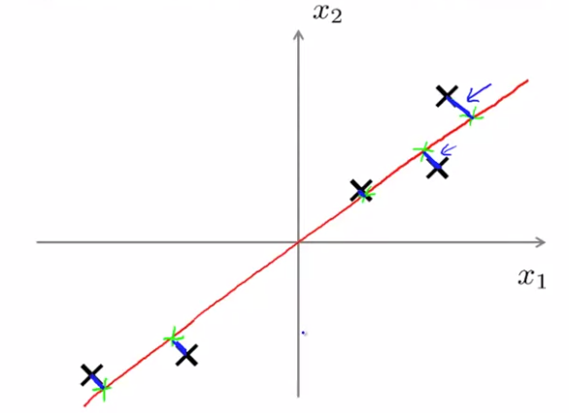
Problem Formulation
Objective: Find the lower dimensional surface to project the data onto it that minimizes projection error
Projection error
Projection error: Distance between a data point and its projected point
Standard Practice: Normalize all the features

Slide 10
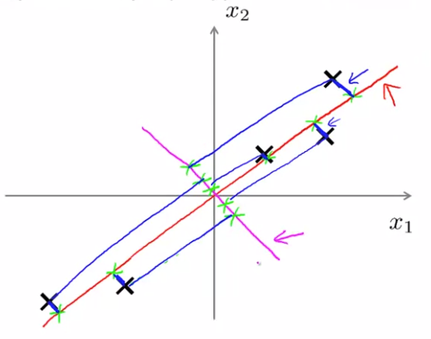
Problem Formulation
Large Projection Error

Slide 11
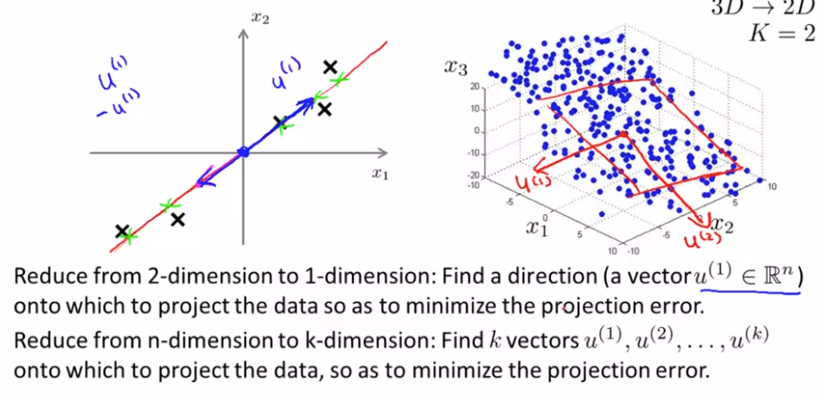
Problem Formulation

Slide 12
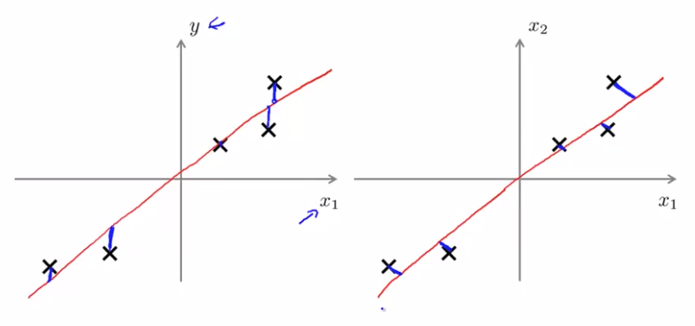
PCA vs Linear Regression
Error based on y
No y (label)
Error based on x1, x2,…

Slide 13
Dimensionality Reducition PCA algorithm

Slide 14
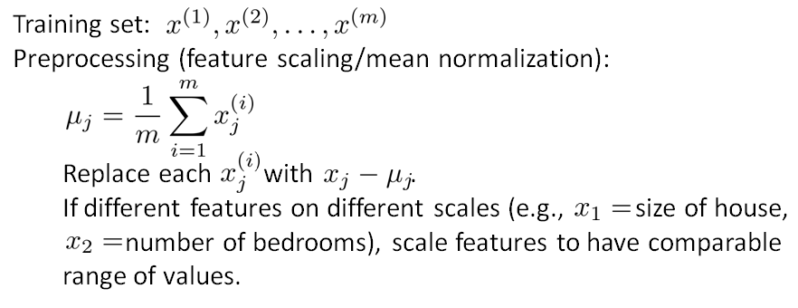
PCA algorithm: Data preprocesing

Slide 15
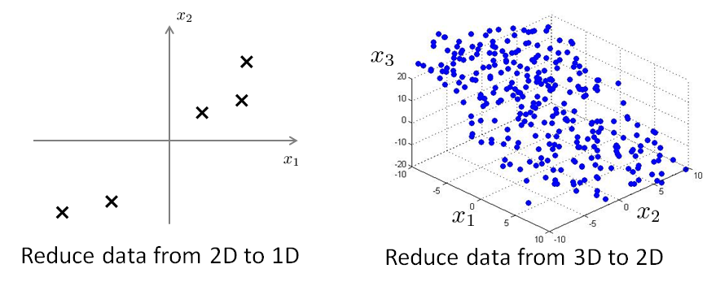
PCA algorithm

Slide 16
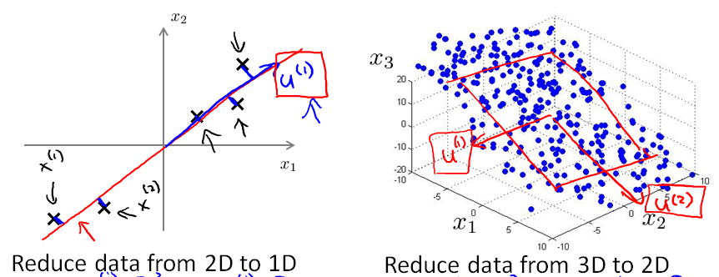
PCA algorithm

Slide 17
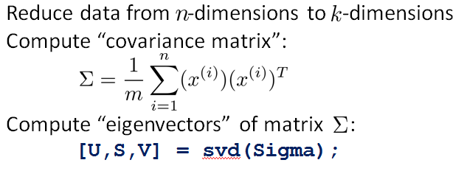
PCA algorithm

Slide 18
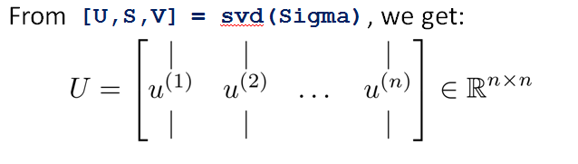
PCA algorithm

Slide 19
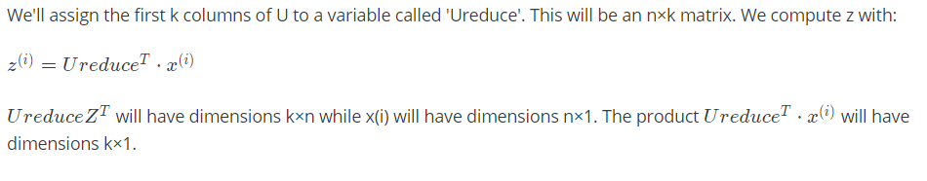
PCA algorithm

Slide 20
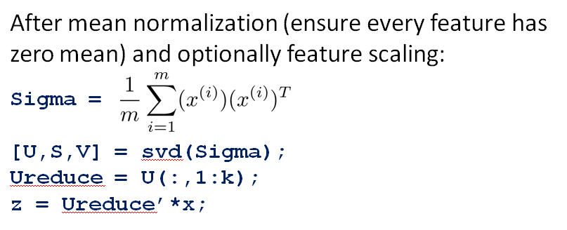
Summary

Slide 21
Reconstruction from Compressed Representation

Slide 22
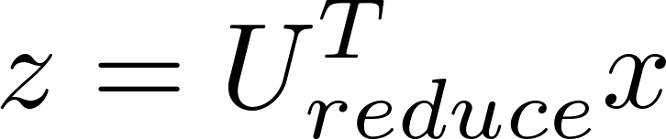

Reconstruction from compressed representation
Notes:
Make points have 0 mean on x1 and x2

Slide 23
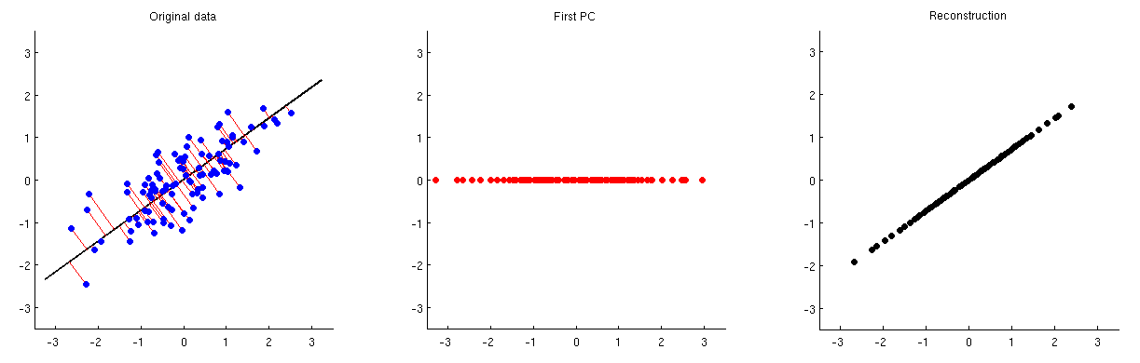
Reconstruction from compressed representation
Notes:
Make points have 0 mean on x1 and x2

Slide 24
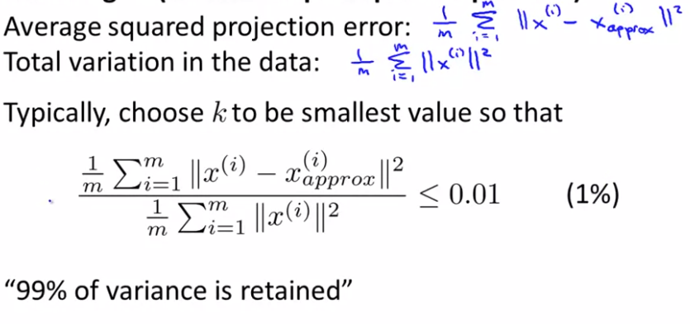
Choosing the number of principal components

Slide 25
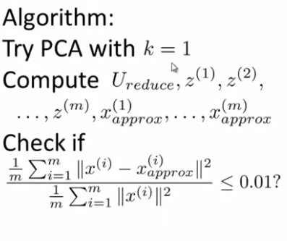
Choosing the number of principal components
Increase k

Slide 26
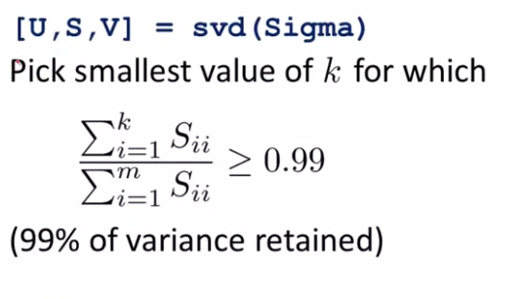
Choosing the number of principal components

Slide 27
Advice for applying PCA

Slide 28

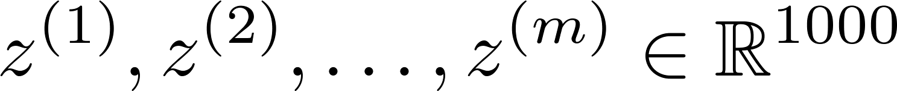
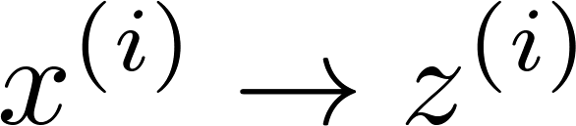
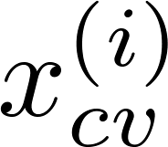
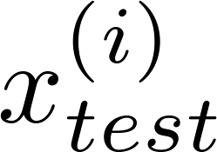
Supervised learning speedup
Expensive computation
1
Extract inputs:
Unlabeled dataset:
2
3
4
New training set:
Note: Mapping should be defined by running PCA only on the training set. This mapping can be applied as well to the examples and in the cross validation and test sets.

Slide 29
Application of PCA
Compression
Reduce memory/disk needed to store data
Speed up learning algorithm
Visualization

Slide 30
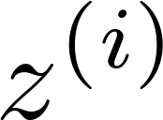
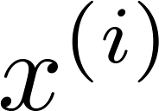

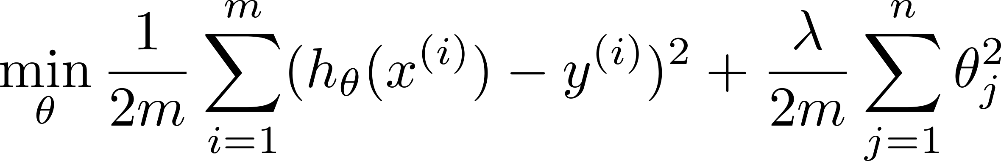
Bad use of PCA: To prevent overfitting
Use instead of to reduce the number of features to
Thus, fewer features, less likely to overfit.
BAD!!
This might work OK, but isn’t a good way to address overfitting. Use regularization instead.

Slide 31





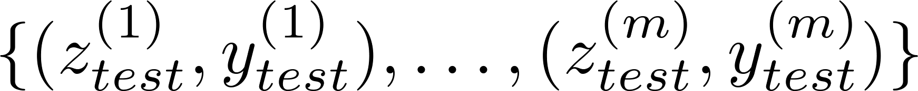
PCA is sometimes used where it shouldn’t be
Design of ML system:
Get training set
Run PCA to reduce in dimension to get
Train logistic regression on
Test on test set: Map to . Run on
How about doing the whole thing without using PCA?
Before implementing PCA, first try running whatever you want to do with the original/raw data . Only if that doesn’t do what you want, then implement PCA and consider using .

